Slide 1
Managing Report Templates
Notes:
Schedule: Timing Topic
<xx> minutes Lecture
<xx> minutes Practice
<xx> minutes Total

Slide 2
Objectives
After completing this lesson, you should be able to do the following:
  Describe the template regions
  Describe the difference between default and override template sections
  Modify a predefined report template
  Register a customized template
  Add a Web link to a template
Notes:
Lesson Aim
<Enter lesson aim here.>

Slide 3
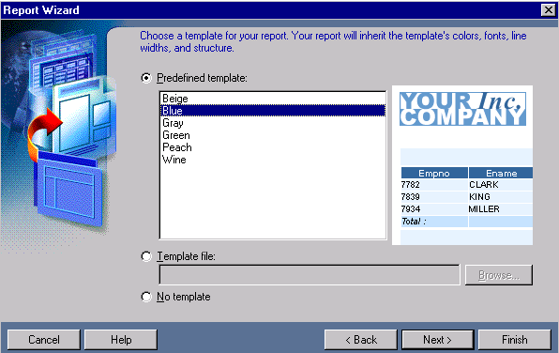
Using Report Templates
For paper reports, you have three template options:
  Predefined
  User-defined
  No template
Installation templates in: <oracle_home>\reports\templates

Slide 4
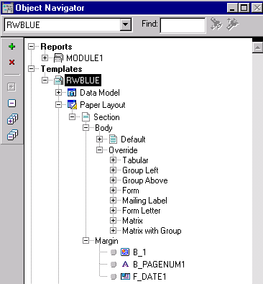
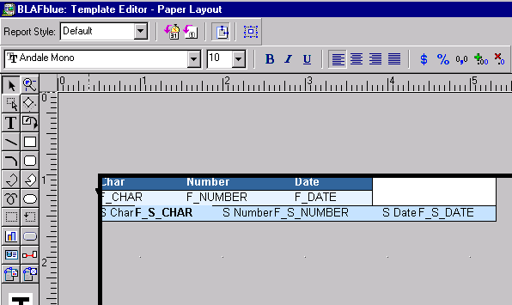

Modifying a Template
Margin
Body

Slide 5
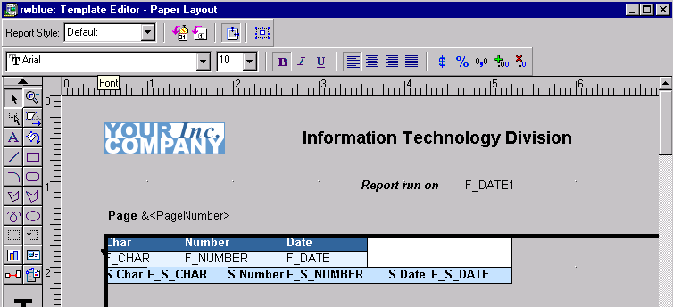
Customizing Template Margin
Include
objects
such as:
  Images
  Text
  Page
  Numbers
  Date

Slide 6
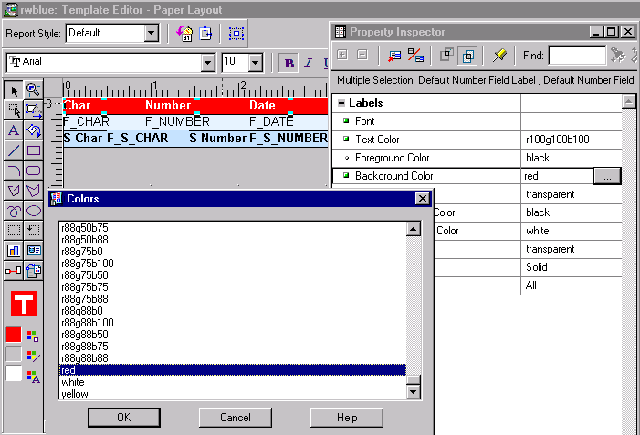
Customizing Template Body

Slide 7
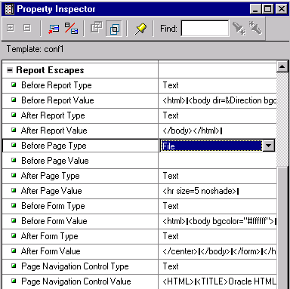
Adding Web Links to a Template for Report HTML Output

Slide 8
Predefining Your Own Templates
  Modify and save template file (mytemp.tdf)
  Move file to template directory: <oracle_home>\reports\templates>
  Register name and description in cagprefs.ora
Reports.Tabular_Template_File =
(rwbeige,
rwblue,
mytemp,
rwgray,
rwgreen,
rwpeach,
Reports.Tabular_Template_Desc =
("Beige",
"Blue",
"My Template Description",
"Gray",
"Green",
"Peach",

Slide 9
Adding a Template Image
  Image area is 200 x 150 pixels
  Image filenames = template name + .bmp
  Move .bmp files to template directory

Slide 10
Summary
  In this lesson, you should have learned how to:
  Modify existing templates to create your own user-defined template
  Modify the default section for all styles or override for individual style changes
  Add your templates to the predefined list
  Display an image for a predefined template
  Add Web links for report HTML output

Slide 11
Practice 6 Overview
  Customizing an existing template
  Applying the modified template to an existing report
  Adding a Web link

